Slide 1

Data/Code driven UI with WPF part 1
How can WPF GUIs be built without XAML?
Wolfgang Riedmann wolfgang@riedmann.it
Xbase.Future 2018 in Köln

Slide 2

Disclaimer
What you will not see in this session:
The absolute truth
The best or the only solution
100% error free and perfectly written code
What you will see instead:
Another (and not commonly used) possibility to build WPF GUIs
A solution to build windows and UserControls dynamically
A possible solution for multilanguage applications
Graphical design without using stylesheets, possible also on an individual base
Hopefully a better understanding how WPF works internally
Xbase.Future 2018 in Köln

Slide 3
Why WPF and not WinForms
Futureproof: WPF is a completely new designed GUI plattform that is not tight to the Windows GUI. If Microsoft will write a platform independent GUI library, then it will be a descendant to WPF
WPF is completely vector oriented and scales from low resolutions on cheap tablets until high resolution devices like 4K monitors
The design of WPF permits nearly unlimited possibilities to build complex UserControls simply assembling them from the base controls
WPF is highly dynamic – windows and controls should not be positioned by specifying coordinates, but by using content controls like panels or grids
WPF has a very powerful databinding and is very well suited for MVVM applications
Xbase.Future 2018 in Köln

Slide 4
What is different in WPF
The VO-GUI-Klassen are using coordinates like WinForms and the entire Windows GDI.
WPF works like HTML with content controls and distances.
It is possible to use WPF als with coordinates (using the CanvasControl), but you will loose the biggest advantage of WPF – the dynamic positioning
To build a WPF windows successfully, as first thing you should think how this window should adapt itself to different screen sizes.
Only if you are sure about this you should start to work.
Only if you respect this your result will work well on very different screen sizes and resolutions.
Xbase.Future 2018 in Köln

Slide 5
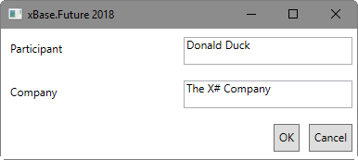
Our target
A simple window, with databinding to a ViewModel for data and actions (Commands)
Xbase.Future 2018 in Köln

Slide 6
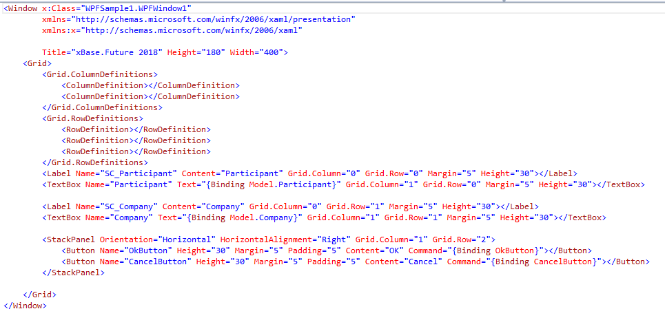
The first try: XAML
Xbase.Future 2018 in Köln
Notes:
XAML: I don‘t like that parameters as „Margin“ and „Height“ are defined many times. The databinding is specified in a complex manner, and I‘m missing the possility for multilingual GUIs. Both the captions and the measures can be defined also by databinding, but this makes the code even more complex and less readable.

Slide 7
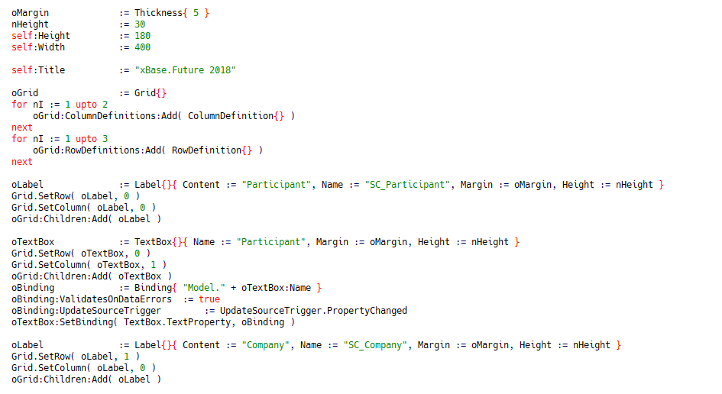
The second try: Code
Xbase.Future 2018 in Köln
Notes:
If we write the window using code we have some advantages: we see immediatly how many rows and columns we have, and margins and heights are defined only once. The code may be look a bit cleaner, but is is much more. We can build it completely in XIDE, but we miss also a preview.

Slide 8
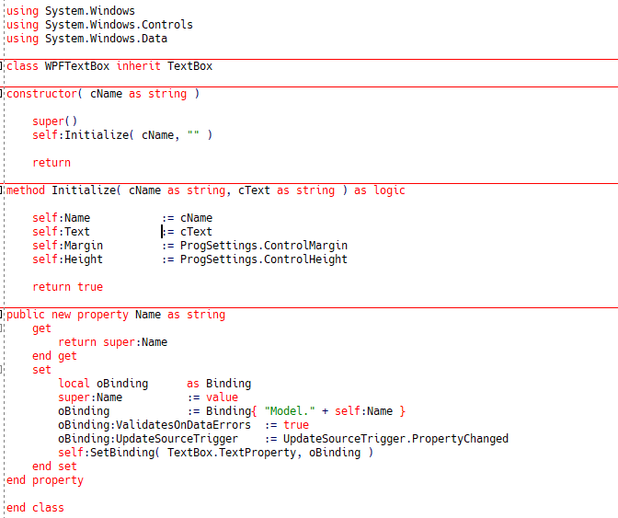
3rd try: Own control classes
Xbase.Future 2018 in Köln
Notes:
We have learned something using VO: don‘t duplicate code, but put it in own classes. As sample you can see the WPFTextBox. The Clou: we copy the name based binding from VO. Automatically the content of the control will be coupled with a field with the same name in the model. All this is done in the Name property. And se set the margin and the height to the applicationwide values.

Slide 9
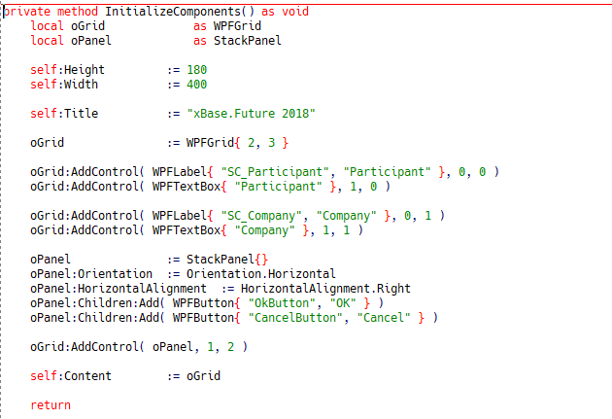
3rd try: The window
Xbase.Future 2018 in Köln
Notes:
Finally we have clean and readable code without loosing functionality!

Slide 10
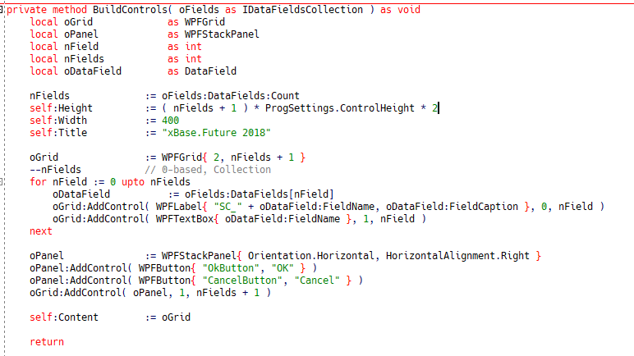
Idea: build a windows dynamically
Xbase.Future 2018 in Köln
Notes:
Using the control classes from the previous sample we can build our window completely dynamic – and we have been arrived at our target. Define your data structure and the window will build itself as needed.

Slide 11
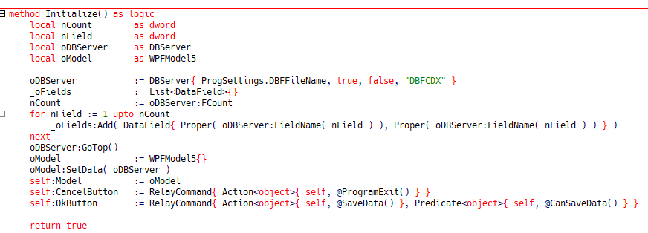
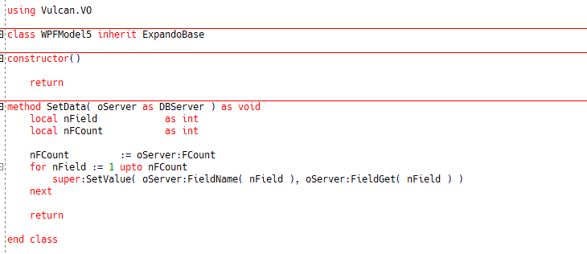
And DBF?
Xbase.Future 2018 in Köln
Notes:
Sometimes at this moment people asks: and with DBF data? My answer: of course, because with the WPF Databinding it is completely irrelevant where the data comes from. To make this in a dynamic way, we need a special class that permits dynamic properties. In some of my VO applications I have data from different data sources in a single window, and with WPF this is also possible, maybe a bit easier

Slide 12
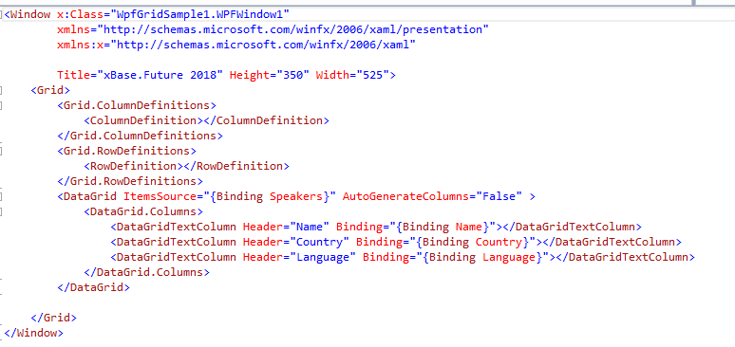
The DataGrid – first in XAML
Xbase.Future 2018 in Köln
Notes:
The DataGrid in its simpliest form does not need any configuration – it displays all columns of the associated datasource. But if you need to specify the columns manually, you need to do this in XAML. This is the main problem in my eyes because it is not possible to configure the columns with databinding.

Slide 13
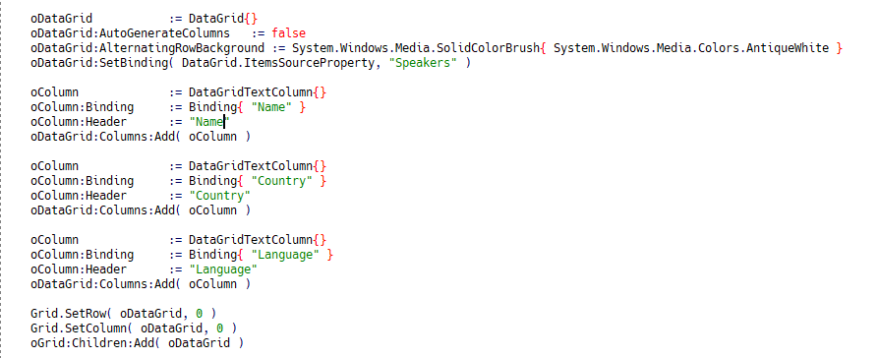
The DataGrid –in Code
Xbase.Future 2018 in Köln
Notes:
Written in code there is more code and the code is less readable than XAML. But is more flexible because the columns can be added depending onm some conditions or in a loop.

Slide 14
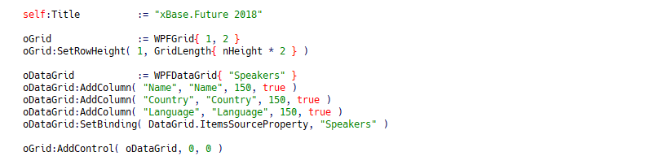
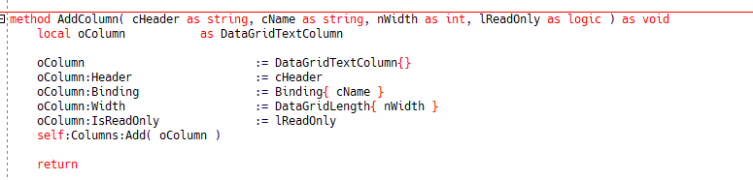
The DataGrid – with an own class
Xbase.Future 2018 in Köln
Notes:
This is much more readable and cleaner code.

Slide 15
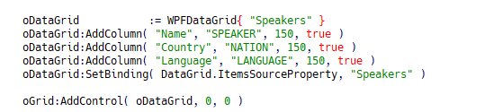
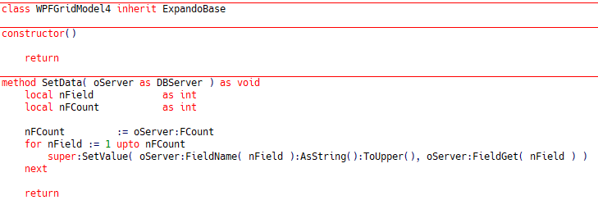
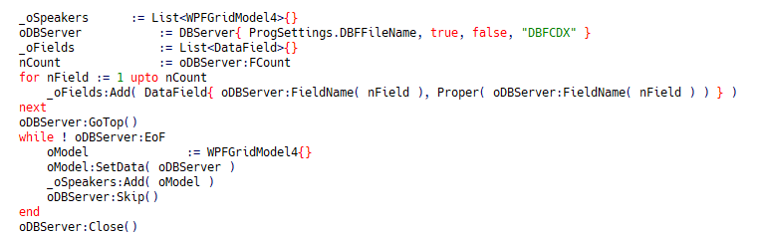
The DataGrid – and with DBF?
Xbase.Future 2018 in Köln
Notes:
For the DBF access we use our ExpandoObject class from one of the previous samples

Slide 16
Finished – Thank you for your attention!
Xbase.Future 2018 in Köln
Notes:
I hope you have learned something from this session – even if you think: never ever I will do something like that!

